Slide 1
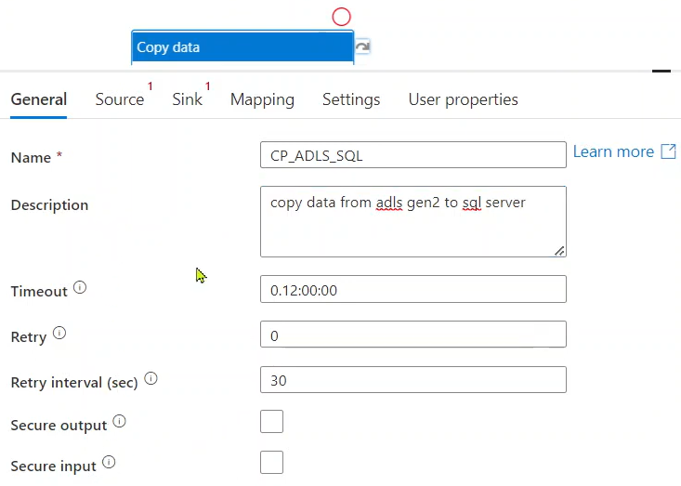
Timeout:
1) What is the maximum amount of time this copy activity going to run.
2) Earlier this timeout was 7 days. ADF team was reduced to 12hours.
3) If the copy activity got stuck due to some reason from long time then it will be timed out after 12 hours of execution and eventually fail the pipeline (to reduce the cost).

Slide 2
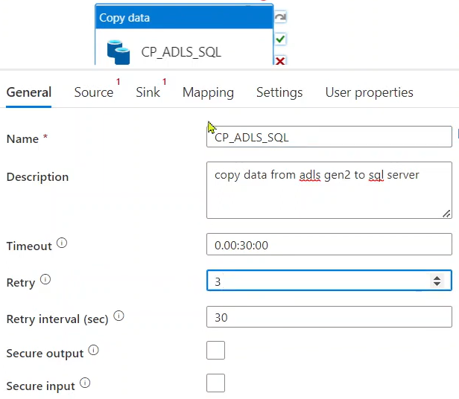
Retry:
After failure of copy activity, it will try 3 more attempts to run this activity.
EX 1: If you have multiple tables that we are trying to copy some data store to your SQL database. Due to overloading in the integration runtime it might fail saying internal server error, memory optimized error. Then it might succeed in subsequent attempts in retry.
EX 2: Suppose you are making call to REST API and at the same time other customers also making same call to the url. At one particular moment it might fail but after several retries it might pass in the second or third attempt.
Retry interval (sec)
This is the number of seconds it will wait in b/n each retry.

Slide 3


